Slide 1
T99X171.00 UI screen broken FA Report
Prepared by : PE Long
Date: 2023/10/06

Slide 2
#1
Establish the Team
Team Leader
Team Member
PE: Michael, Long
ME: Cheng Lun, Hugo
PM: An Tran, Roisy
PD: Wen Yong
QA: Ken, Robert
TE: Allan, Jones
IE: Hai Ly, Heng Ruan
Foxconn
  MFG Director: David Yin
  QA Manager : CB Lin, Toney
Notes:
MA5800-X7#display cable modem <MAC> detail

Slide 3
#2
Problems description -1
Issue Description ( 5W2H)
When | 2023/07/27
Who | ALT customer
Where | SK networks warehouse, Anseong, Korea.
What | ALT customer feedback that they found out 1/1000pcs has UI screen is unstable (broken). Defect rate: 1/1000 = 1000 DPPM
Why | Follow SoC material (P/N: 002.02753.005. DC: 2309, Vendor: AMLOGIC)
How | UI screen is unstable (broken).
How many | Total 1pcs (Defect rate: 1/1000 = 1000 DPPM) as below table.
No | Description Issue | S/N | MAC | Fail rate
1 | UI screen is unstable (broken) | 2149688001202301117565 | BCF4D4F8BF3B | 1000 DPPM
Notes:
MA5800-X7#display cable modem <MAC> detail

Slide 4
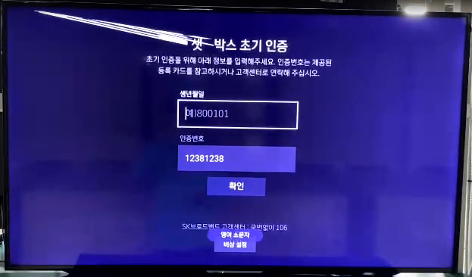
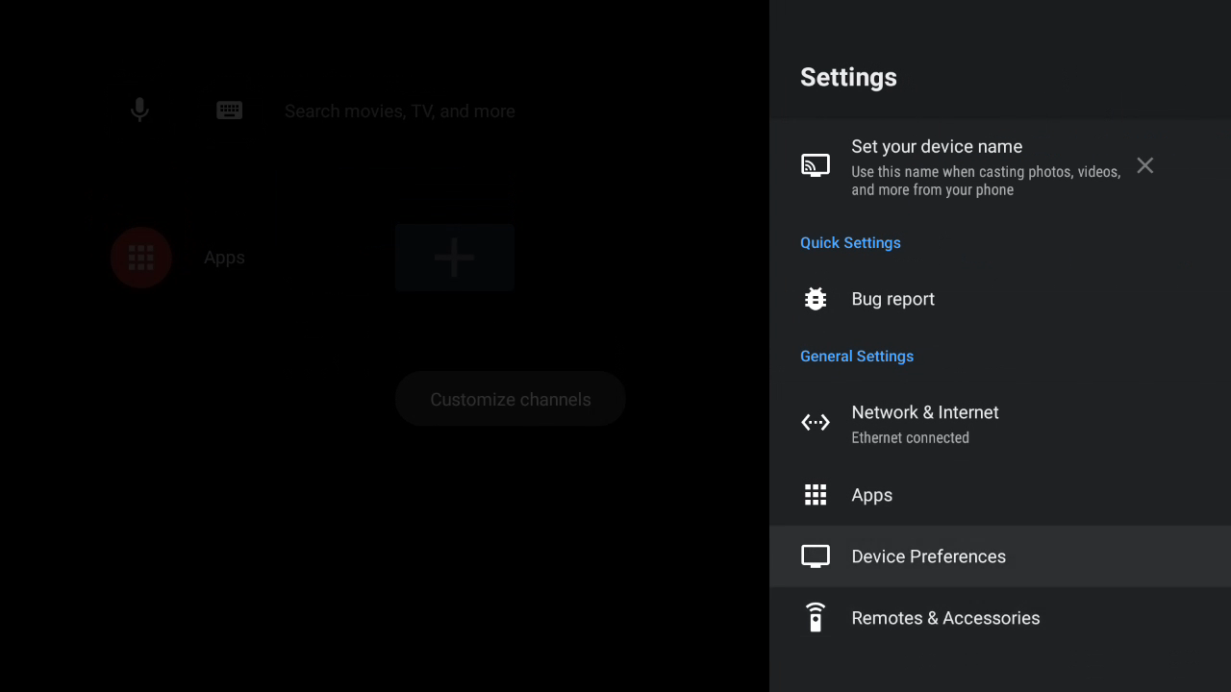
#3
Problems description -2
UI screen is unstable (broken).
Summary:
- UI screen is unstable (broken).
Note: Please watching video
Notes:
MA5800-X7#display cable modem <MAC> detail

Slide 5
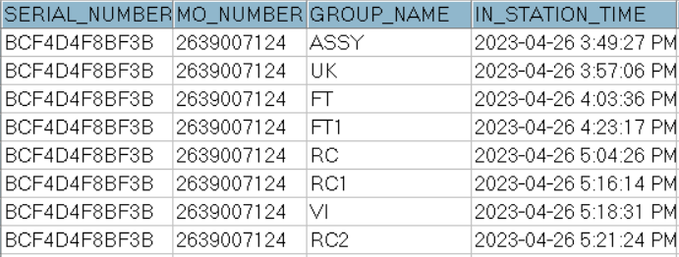
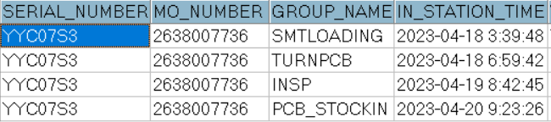
#4
Data checking
1. Recheck production data record.
2. Recheck test log
Dot level
T level
No# | Station | Status
1 | UK | PASS
2 | FT (test HDMI) | PASS
3 | FT1(test HDMI) | PASS
4 | RC | PASS
5 | RC1 | PASS
6 | RC2 | PASS
Summary:
- Recheck production data record and test log ➔ Did not find out any abnormal.
Notes:
MA5800-X7#display cable modem <MAC> detail

Slide 6
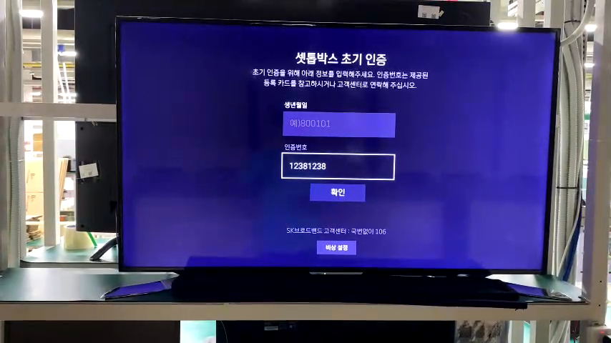
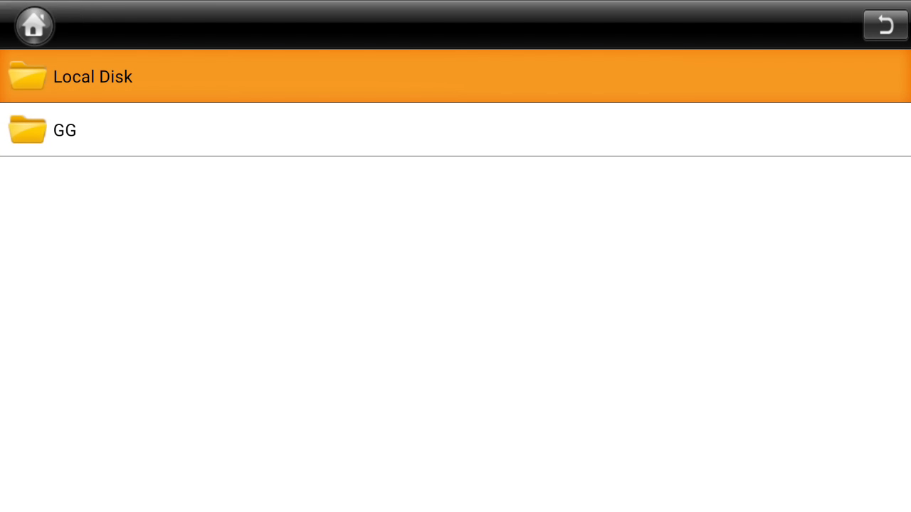
#5
OBA + FATP verify
1. Retest NG sample at OBA station.
UI screen is unstable (broken).
2. Upgrade again factory FW and test NG sample at FT, FT1 station, the result as below:
Screen broken
No. | Station | Result
1 | FT | Pass
2 | FT1 | Pass
Summary: The fail symptom same as customer feedback.
- Retest NG sample at FT, FT1 station ➔ Pass normally.
➔ FATP station can’t cover this issue
Note: Please watching video
Notes:
MA5800-X7#display cable modem <MAC> detail

Slide 7
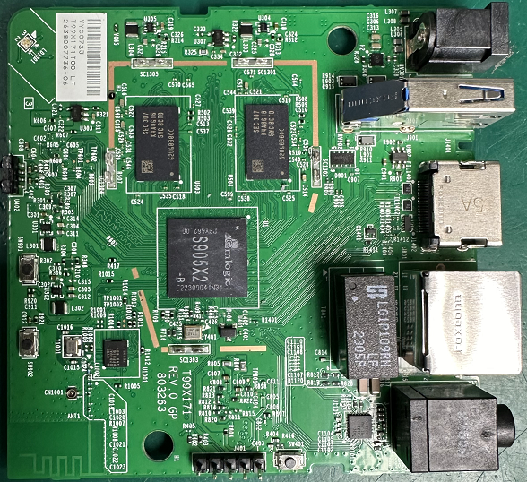
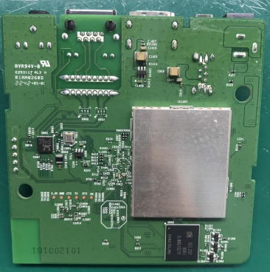
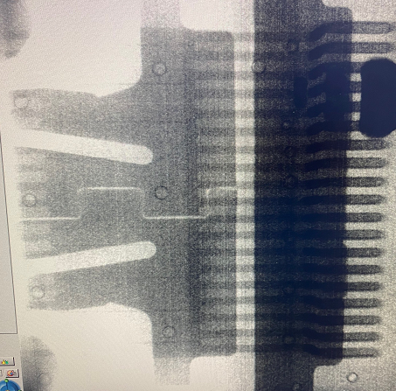

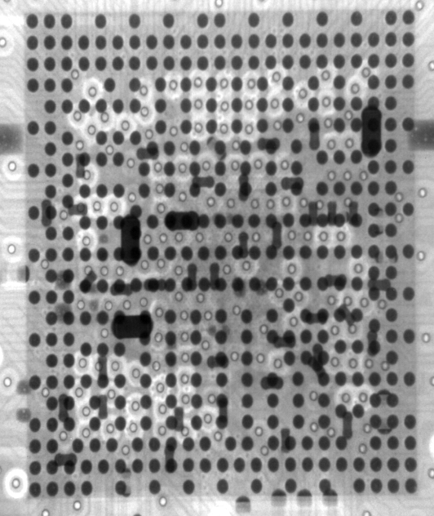
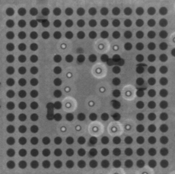
#6
Board Level -1
1. Check Visual inspection and take X-ray NG sample, result as below:
Item | Top side | Bottom side | Result
Visual inspection |  |  | No abnormality
Item | SoC | eMMC | HDMI Connector | Filter | Result
X-ray |  |  |  |  | No abnormality
Summary:
- Check visual inspection and take X-ray ➔ Result: No abnormality
Notes:
MA5800-X7#display cable modem <MAC> detail

Slide 8
#7
Board Level -2
2. Measure impedance /VF on board HDMI connector of NG sample and compare with OK sample, result as table below:
Impedance/VF measurement on board HDMI Connector
Pin No | Pin Name | Description | NG sample |  | OK sample
 |  |  | Impedance (Ω) | VF | Impedance (Ω) | VF
1 | TX2+ | HDMI TMDS data2 negative output | 3.21M | 0.683 | 3.2M | 0.68
2 | TX2_shield | System Ground | 0 | 0 | 0 | 0
3 | TX2- | HDMI TMDS data2 positive output | 3.226M | 0.68 | 3.2M | 0.68
4 | TX1+ | HDMI TMDS data1 positive output | 3.224M | 0.68 | 3.2M | 0.68
5 | TX1_shield | System Ground | 0 | 0 | 0 | 0
6 | TX1- | HDMI TMDS data1 negative output | 3.221M | 0.68 | 3.2M | 0.68
7 | TX0+ | HDMI TMDS data0 positive output | 3.220M | 0.68 | 3.2M | 0.68
8 | TX0_shield | System Ground | 0 | 0 | 0 | 0
9 | TX0- | HDMI TMDS data0 negative output | 3.221M | 0.68 | 3.2M | 0.68
10 | TXC+ | HDMI TMDS clock positive output | 3.215M | 0.68 | 3.2M | 0.68
11 | TXC_shield | System Ground | 0 | 0 | 0 | 0
12 | TXC- | HDMI TMDS clock negative output | 3.21M | 0.68 | 3.2M | 0.68
13 | CEC | General purpose input/output bank H signal 3 | 2.4M | 0.69 | 2.2M | 0.69
14 | NC | Not Connect | NA | NA | NA | NA
15 | SCL | General purpose input/output bank H signal 1 | 1.2M | 0.61 | 1.2M | 0.62
16 | SDA | General purpose input/output bank H signal 0 | 1.11M | 0.61 | 1.01M | 0.61
17 | GND | System Ground | 0 | 0 | 0 | 0
18 | 5V | HDMI_PW | 1.12M | 0.50 | 1.2M | 0.55
19 | HPD | General purpose input/output bank H signal 2 | 110K | 0.69 | 110K | 0.69
Summary: Did not find out abnormal with impedance of NG sample
Notes:
MA5800-X7#display cable modem <MAC> detail

Slide 9
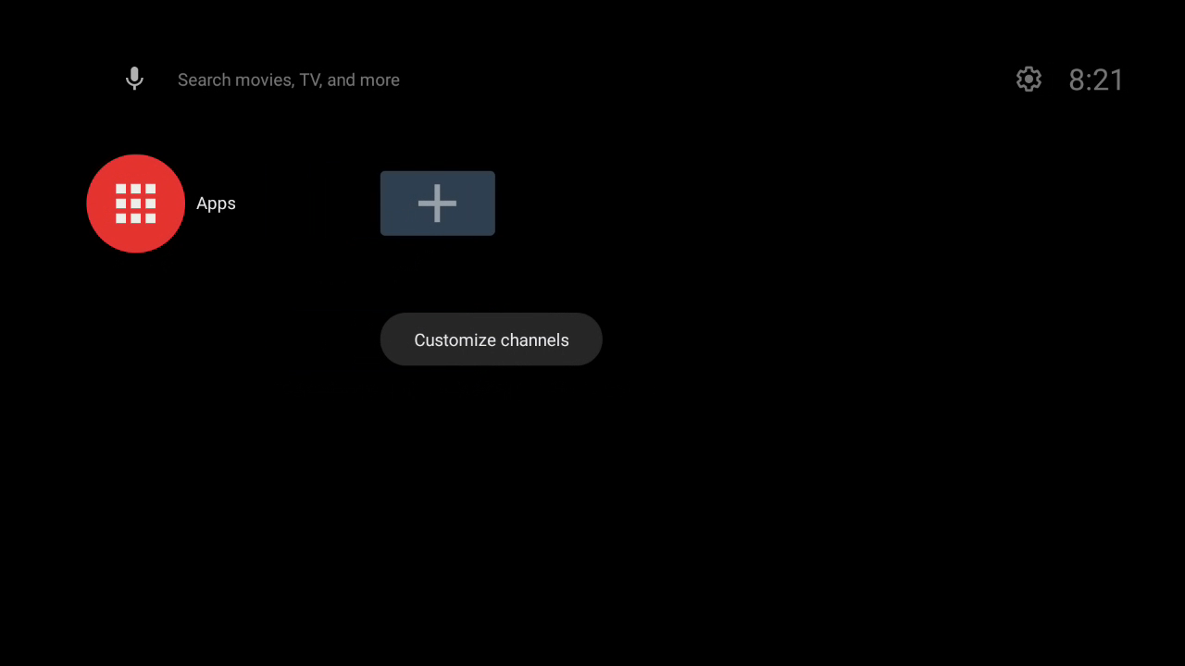
#8
Board Level - 3
3. Change component of HDMI block and retest screen TV. :
- Change new SoC
➔ Result: Pass 5/5 times. This issue follow SoC component.
TV screen OK
Summary:
- This issue follow SoC (P/N: 002.02753.005, DC: 2309,Vendor: AMLOGIC) material have issue.
Note: Please watching video
Notes:
MA5800-X7#display cable modem <MAC> detail

Slide 10
#9
Component level - 1
1. Removed SoC and measure HDMI block pin, result as table below:
SoC-U1 HDMI pin impedance measurement
SoC_PIN NAME | Description | OK SoC Sample |  | NG SoC sample
 |  | Impedance | VF | Impedance | VF
C43 | HDMI TMDS data2 negative output | 8.81MΩ | 0.76 | 8.56MΩ | 0.767
C45 | HDMI TMDS data2 positive output | 8.71MΩ | 0.76 | 8.56MΩ | 0.767
E45 | HDMI TMDS data1 positive output | 8.61MΩ | 0.76 | 8.57MΩ | 0.766
G43 | HDMI TMDS data1 negative output | 8.61MΩ | 0.76 | 8.56MΩ | 0.766
J41 | HDMI TMDS data0 positive output | 8.65MΩ | 0.76 | 8.45MΩ | 0.764
J43 | HDMI TMDS data0 negative output | 8.63MΩ | 0.76 | 8.43MΩ | 0.764
L43 | HDMI TMDS clock positive output | 8.54MΩ | 0.76 | 8.33MΩ | 0.763
L45 | HDMI TMDS clock negative output | 8.64MΩ | 0.76 | 8.33MΩ | 0.763
N41 | General purpose input/output bank H signal 1 | 2.52MΩ | 0.71 | 2.69MΩ | 0.721
N43 | General purpose input/output bank H signal 3 | 2.64MΩ | 0.75 | 2.70MΩ | 0.746
R43 | General purpose input/output bank H signal 0 | 2.49MΩ | 0.71 | 2.655MΩ | 0.724
R45 | General purpose input/output bank H signal 2 | 2.61MΩ | 0.74 | 2.694MΩ | 0.729
AG45 | General purpose input/output bank H signal 4 | 2.91M | 0.78 | 3.182MΩ | 0.788
Summary: Measure impedance/VF HDMI pins of NG SoC ➔ Did not find out any abnormality
Notes:
MA5800-X7#display cable modem <MAC> detail

Slide 11
#10
Component level - 2
2. Reball and do a swap verification SoC
Check Screen HDMI | 1 | 2
OK board + OK SoC | OK | OK
NG board + NG SoC | NG | NG
OK board + NG SoC | NG | NG
NG broad + OK SoC | OK | OK
Summary:
- As analyzed above this issue follow U1-SoC( P/N: 002.2753.005, DC: 2309, Vendor: AMLOGIC ) component.
Notes:
MA5800-X7#display cable modem <MAC> detail

Slide 12
#11
Action
1. RD Jerry and TE Jones have completed the following test verification.
- Use commands to move the selected item in the settings menu to verify this issue.(One per second)
- Use the developed application to optimize item 1 and dynamically adjuset the test frequency. (Dynamically adjust time)
2. The conclusion as below:
- The frequency of this issue does not occur every time.
- It is not in the same location and is dynamically displayed in differnet positions on the screen.
Summary: FATP cannot be checked through software.
Notes:
MA5800-X7#display cable modem <MAC> detail

Slide 13
#12
Corrective Action
Root cause:
- Occur cause: Follow U1 SoC (P/N: 002.02753.005, DC: 2309, Vendor: AMLOGIC) have material issue.
- Escape cause: FATP can’t cover issue.
Short term:
Co-work with RD, TE team, how to cover this issue at FATP ,Owner :RD Jerry ,TE Jones. Duedate: 09/28
On 09/27, after verify RD and TE confirm FATP can’t cover issue.
Send FA report and NG SoC material to vendor AMLOGIC for futher analyzing and taking action for this issue. Owner: SQE Naomi. Due date: 10/08.
Notes:
MA5800-X7#display cable modem <MAC> detail

